Slide 1
Complex Event Modelling in Elasticsearch
Nesting

Slide 2
Presentation Purpose
This presentation assumes that you are aware of - and want to take advantage of - the elasticsearch featureset. E.g.
Functional features - match queries, common terms queries, synonyms, search templates, scroll, custom scoring, percolate queries, more like this queries, etc….
Non Functional features - fast search, cluster management, container compatible.
However your events are complex so you are not sure how to configure elasticsearch to support your use case.

Slide 3
Background On Our Requirements
Our use case - Australia’s FIU - financial transactions.
Data holdings growing by 100+ million events each year.
Data streaming in from over 1,300 entities from different industries, with different levels of sophistication, volume, data quality - third party information.
No registry of entities to match the parties on the incoming data feed.
Significant effort is required to standardise and embellish reported data before it is made available for analysis. The standardisation and embellishment processing is constantly evolving, and when changes are made these changes are required to be applied to all historical data.
Thus the search datastore is required to be reloaded from scratch when changes are made.

Slide 4
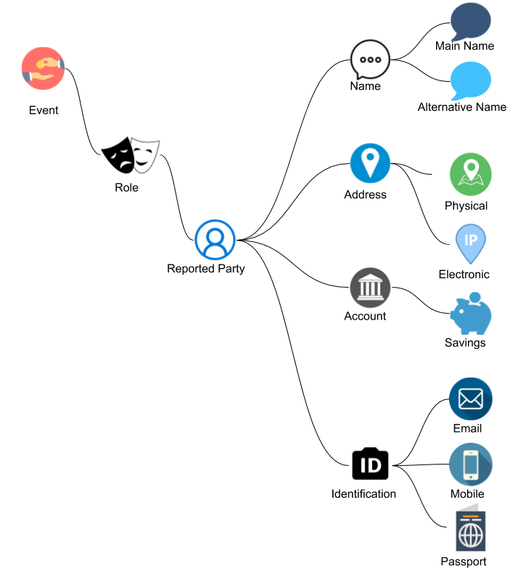
Our Product Model
Event - transaction and parties
Reported events are deeply nested with every level of the hierarchy a repeating group. I.e.
Multiple Roles within an Event
Multiple Reported Parties within a Role
Multiple Names within a Party
Multiple Addresses within a Party
Multiple Accounts within a Party
Multiple Ids within a Party
Average 10K data, 4 parties per event
Analysis is required to be supported at every level of the hierarchy (e.g. searches, aggregations, and groupings).

Slide 5
How to Model This Data
Historical approaches included;
Normalised database structures (relational tables with distinct values). However did not scale as transactional integrity is required to be maintained. Limit to vertical scalability.
De-normalised database structure (flat or partially flat table). However resulted in ultra wide rows leading to complex queries and aggregations of search results.
New technologies provided new approaches so we took on some discovery work to investigate new technologies. Elasticsearch was one of the tools taken into this discovery process.

Slide 6
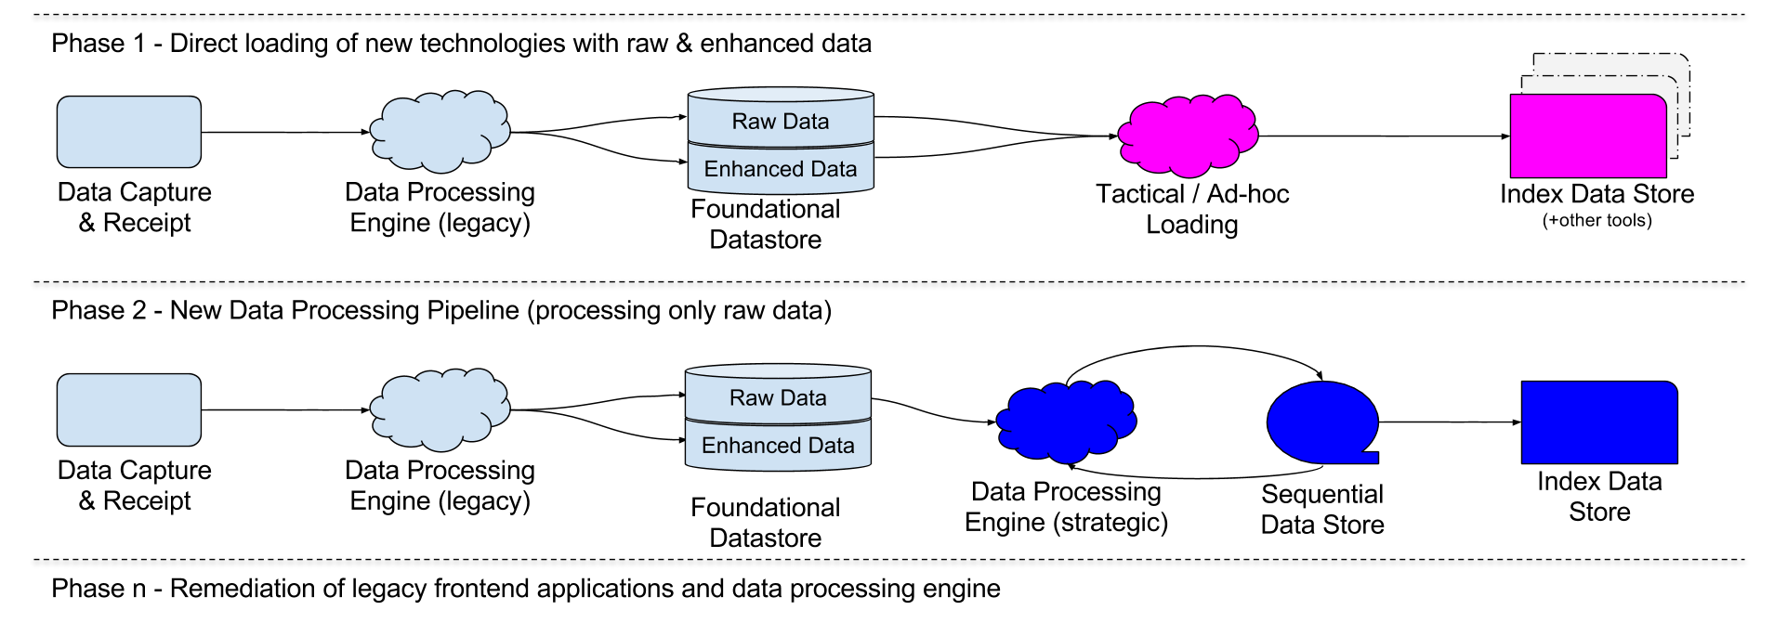
Broader Architectural Context (+ Phasing)

Slide 7
Elastic Stack In Phase 1 + Phase 2
Phase 1
Elastic stack was well suited to type of approach.
Primary effort was logstash configuration - just configuration - not real code.
Lots of repetition allowed us to come up to speed with the technology.
Provided access to all raw data (something the business have never had before)
Basically schema-less approach / flat structure (works well with Kibana)
Phase 2
Pull data from strategic data pipeline.
Move to a nested index structure.
Move to custom frontend (i.e. away from kibana)

Slide 8
Default Mapping Limitation 1 (cross matching within a field)
1 High St Brisbane hit with default mapping
name | Address
Lilly Smith | 1 High St Sydney, 2 Low St Brisbane
{
"name": "Lilly Smith"
},
{
"address": "1 High St Sydney"
},
{
"address": "2 Low St Brisbane"
}
Default mapping
name | Address
Lilly Smith
 | 1 High St Sydney
 | 2 Low St Brisbane
Nested mapping

Slide 9
Default Mapping Limitation 2 (cross matching across fields)
1 High St Brisbane hit with default mapping
{
"name": "Lilly Smith"
},
{
"address": "1 High St",
"suburb": "Sydney"
},
{
"address": "2 Low St",
"suburb": "Brisbane"
}
name | Address | Suburb
Lilly Smith | 1 High St, 2 Low St | Sydney, Brisbane
Default mapping
name | Address | Suburb
Lilly Smith
 | 1 High St | Sydney
 | 2 Low St | Brisbane
Nested mapping

Slide 10
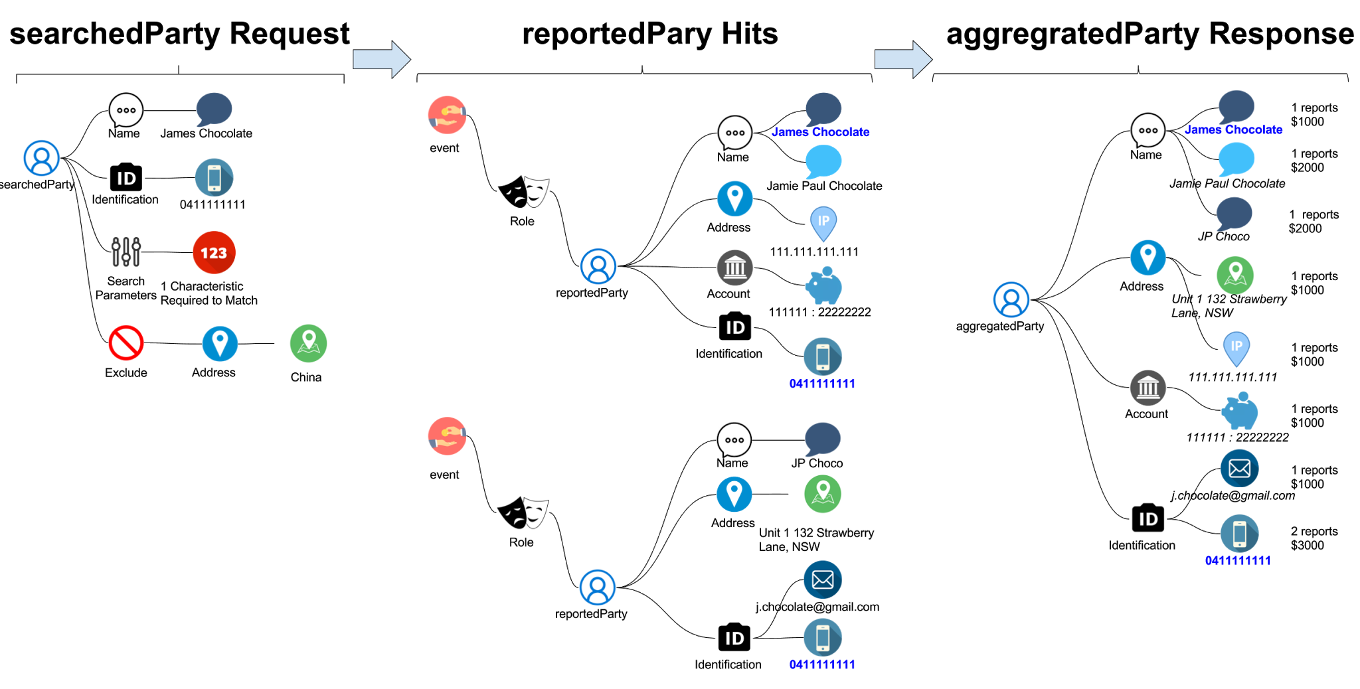
partySearch
With a nested index we can perform searching and aggregation on each level of the hierarchy.
The example to the right shows how you can search reported parties with specific characteristics and return aggregated results.

Slide 11
Elasticsearch Experiences to Share
Based on our configured mapping data storage reduced by just over 50% with the move from elasticsearch 5.5.1 to 6.rc.1.
Never provide access to Kibana without configuring the breaker settings.
Set the Kibana queryString:options to have a default_operator of AND. This is how business people expect that kibana search bar to work.
Consider using a combination of spinning and SSD hosts in your production cluster with replicas on each (then review the preference search request setting) - hopefully saving you some cash.
Oracle vs Open Java.
Things are changing pretty fast so you really need to keep an eye on the elastic blog to see what’s coming down the line.

Slide 12
Questions & Conclusion
Questions
Slides and nested worked example can be found here → https://github.com/swarmee/partySearch
Good Luck !

Slide 13
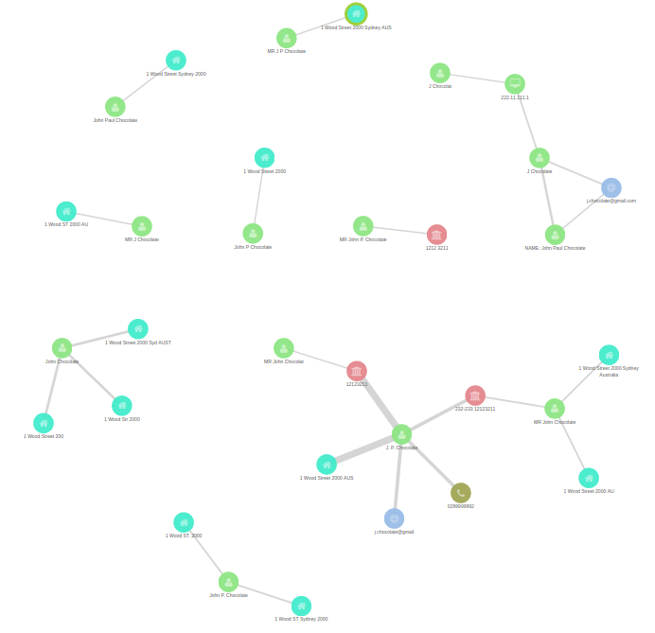
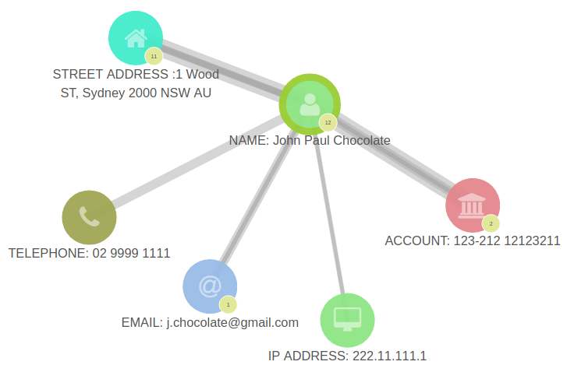
Absence of Unique Keys (lots of fuzzy linkages)

